Slide 1


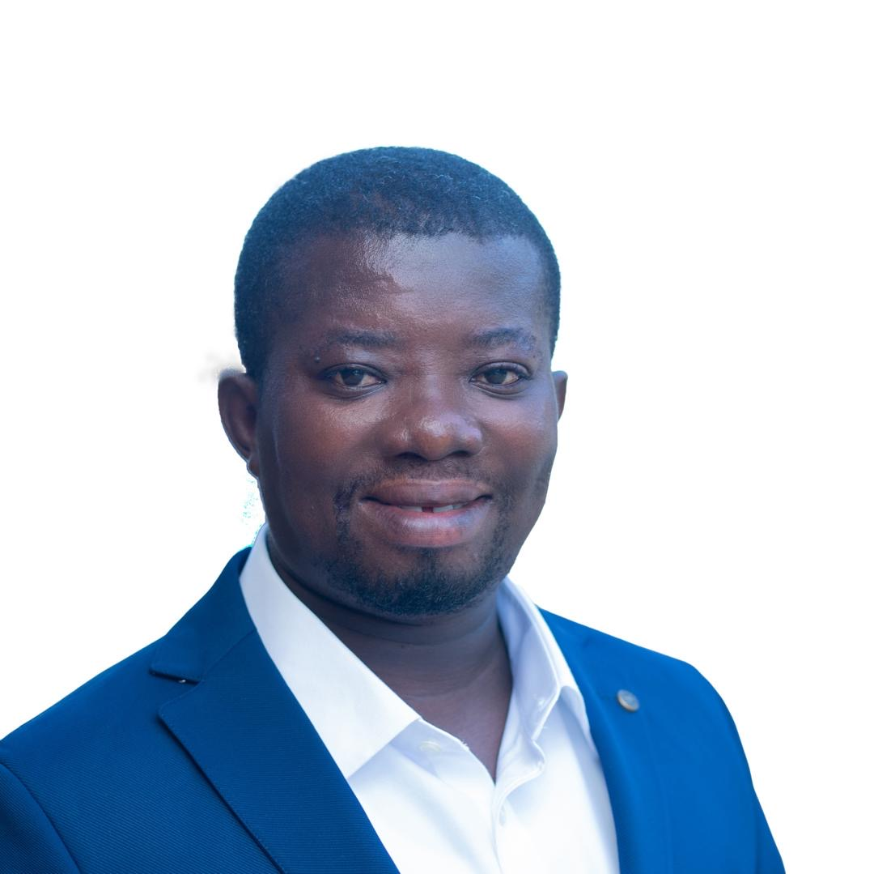
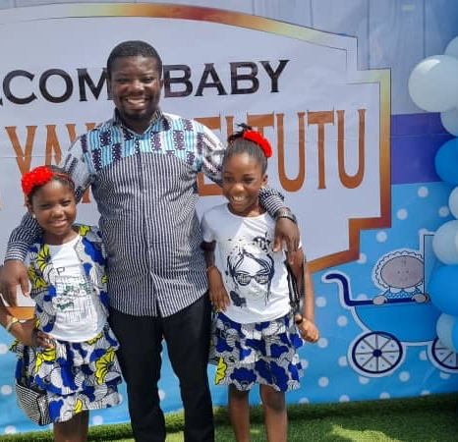

Getting to Know Me
Work
Personal
My role
Procurement Coordinator
Significant others / family members / furry friends in my life
Mother & Aunties
Tenure in ofi/Olam
21 Years
How I enjoy spending my free time
Reading the bible, news and social media
Previous companies I have worked at
Adwumapa buyers Ltd
My favorite / comfort food
Fufu with chicken light soup
Why I joined ofi/Olam and what keeps me here?
Brand Equity and opportunity for growth
My favorite song
It wasn’t easy by Cece Winans
Patrick Gyapong
‘Patrick’
I believe food tastes better when shared
This is me outside work, doing stuff I enjoy in my life …

